Slide 1

Microkernel Architecture (Plugin-architecture Pattern)
Software Architecture
3rd Year – Semester 1
By Udara Samaratunge

Slide 2
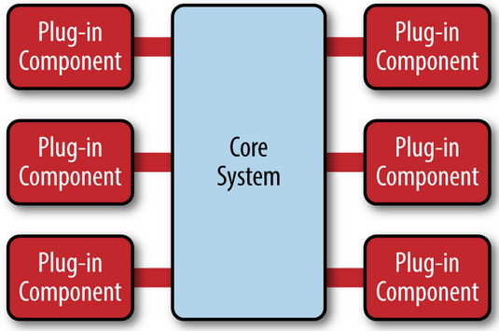
Plugin-architecture Pattern
Two Components
  Core System
  Plugin module
The plug-in modules are stand-alone, independent components.
Core system needs to know about which plug-in modules are available (uses Plugin registry)
OSGi represents Microkernel Architecture for its plugin development.

Slide 3
What is OSGi?
OSGi (Open Services Gateway initiative)
OSGi is a framework which allows modular development of applications using java.
A Java framework for developing (remotely) deployed service applications, that require:
  Reliability
  Large scale distribution
  Wide range of devices
  Collaborative
Created through a collaboration of industry leaders
  IBM, Ericsson, Nokia, Sony, Telcordia, Samsung, ProSyst,
  Gatespace, BenQ, Nortel, Oracle, Sybase, Espial, and many more

Slide 4
OSGi containers allow you to break your application into individual modules. (are jar files with additional meta information and called bundles in OSGi terminology)
Manage the cross-dependencies between modules.
An OSGi framework then offers you dynamic loading/unloading, configuration and control of these bundles - without requiring restarts.
Major Framework vendors are
  ProSyst,
  Gate space Telematics, and
  IBM
  Siemens
  Espial
Open source implementations
  Apache Felix
  Eclipse Equinox
  Gate space Knopflerfish

Slide 5
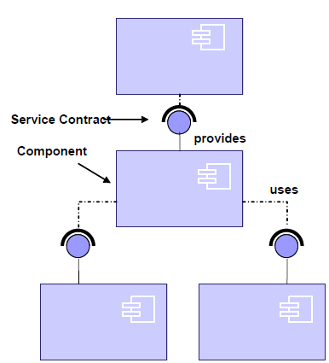
The OSGi Platform vs Service Oriented Architectures (SOA)
Separate the contract from the implementation
Allows alternate implementations
Dynamically discover and bind available implementations
Binding based on contract (interface definitions)
Components are reusable
Components are not coupled to implementation details of other components, only their independent interfaces have to be known

Slide 6
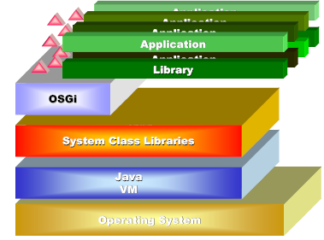
The OSGi Framework Architecture
Allows applications to share a single Java VM.
Handles all class loading in a much better defined way than standard Java.
  Versioning!
Gives isolation/security between applications.
Mediates between communication & collaborations between applications.
Provides life cycle management (install, start, stop, update, etc).
Policy free
  Policies are provided by bundles

Slide 7
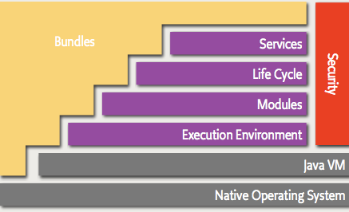
OSGi Bundle Architecture
The following list contains a short definition of the terms:
  Bundles - Bundles are the OSGi components made by the developers.
  Services - The services layer connects bundles in a dynamic way by offering a publish-find-bind model for plain old Java objects.
  Life-Cycle - The API to install, start, stop, update, and uninstall bundles.
  Modules - The layer that defines how a bundle can import and export code.
  Security - The layer that handles the security aspects.
  Execution Environment - Defines what methods and classes are available in a specific platform.

Slide 8
What is a Bundle?
In Java terms, a bundle is a plain old JAR file.
In standard Java everything in a JAR is completely visible to all other JARs.
But OSGi hides everything in that JAR unless explicitly exported.
Reason for hiding is to maintain multiple versions of the same library.
By default, there is no sharing.

Slide 9
Practical Example
Eg :- I have an application that is interacting with underlying MySQL database and after few month I found that MySQL team has fixed a major bug in their new version of mysql-connector library release so in order to incorporate this new library in my traditional application I have to stop my application and re-package it (or just replace the older one)
But, with OSGI we don’t need to stop the whole application because everything is exposed either as a component or as a service therefore we just need to install new component/service in OSGI container.
when the services/components are updated in OSGI container there are various event listeners that propagate the service/component update event to service/component consumers.
And accordingly consumers adapts themselves to use new version of web service (on the consumer side we need to listen for various events so that consumers can decide whether to respond for change or not.

Slide 10
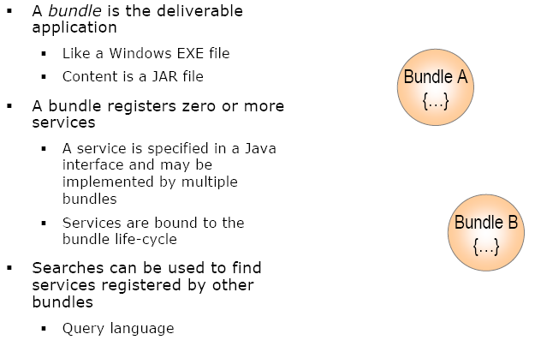

Slide 11

Practical Example
Dictionary Service
IDictionaryService
Client Service
Boolean checkWord(word)
Bundle ID = 11
OSGi Framework bundle
Service subscriber 1
Client 1
Service subscriber 2
Dictionary Service
Client 2
Bundle ID = 12
Bundle ID = 10
Client 3
Service subscriber 3
Publish the service
Bundle ID = 14
Bundle ID = 13
OSGi Environment

Slide 12
Practical Example
Dictionary Service
IDictionaryService
Dictionary Service
IDictionaryService
Client Service
Boolean checkWord(ArrayList<String> words)
Boolean checkWord(word)
Old service
Dictionary Service
OSGi Framework bundle
Client 1
Service subscriber 1
Client 2
Service subscriber 2
Dictionary Service
Client 3
Service subscriber 3
Modified service
OSGi Environment

Slide 13
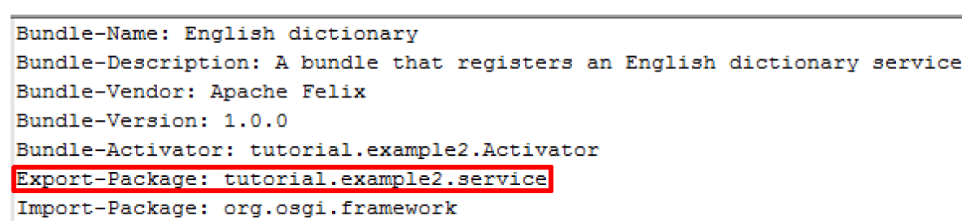
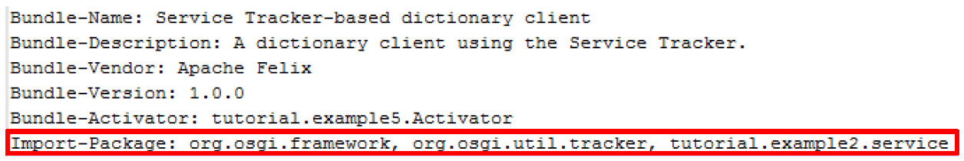
OSGi Environment
Dictionary Service
IDictionaryService
Manifest file
Client Service
Manifest file
Service Activator
Boolean checkWord(word)
Service Activator
IDictionarySevice
DictionarySeviceImpl
Dictionary Service Manifest file
Client Manifest file

Slide 14
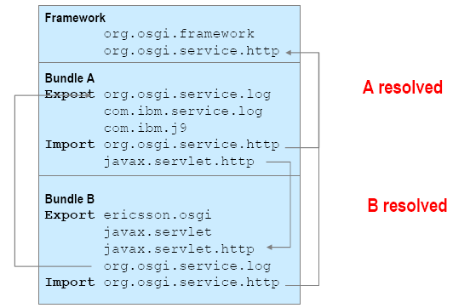
Bundle Deployment
Bundles are deployed on an OSGi framework, the bundle runtime environment.
This is not a container like Java Application Servers. It is a collaborative environment.
Bundles run in the same VM and can actually share code.
The framework uses the explicit imports and exports to wire up the bundles so they do not have to concern themselves with class loading.

Slide 15
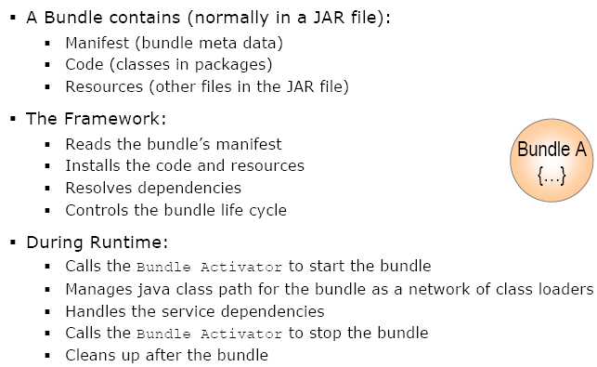

Slide 16
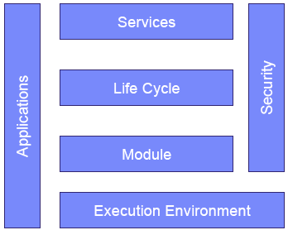
OSGi Service Platform Layering
The OSGi Service Platform is divided in a number of layers.
Execution Environment provides a defined context for applications.
The Module layer provides class loading and packaging specifications.
The Services layer provides a collaboration model.
The extensive Security layer is embedded in all layers.

Slide 17
OSGi Service Layer
Provides an inside-VM service model
  Discover (and get notified about) services based on their interface or properties, no protocol required
  Bind to one or more services by
    program control,
    default rules, or
    deployment configuration
Service Oriented Architectures (SOA) Confusion
  Web services bind and discover over the net
  The OSGi Service Platform binds and discovers inside a Java VM
The OSGi Alliance provides many standardized services
OSGi defines a standard set of services
  Other organizations can define more (AMI-C, Ertico, JCP)

Slide 18
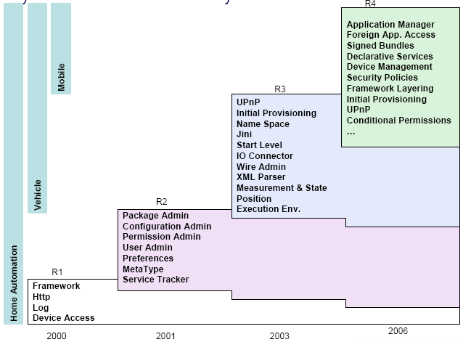
The OSGi Service Layer Evolution

Slide 19
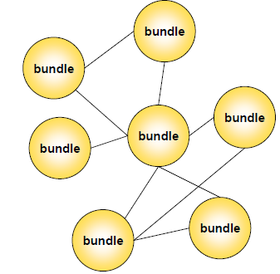
OSGi Module Layer
Packaging of applications and libraries in Bundles
  Java has significant deployment issues
Class Loading modularization
  Java provides the Class Path as an ordered search list, which makes it hard to control multiple applications
Protection
  Java can not protect certain packages and classes from others.
Versioning
  Java can not handle multiple versions of the same package in a VM

Slide 20
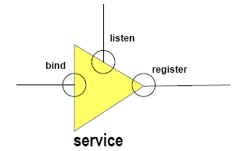
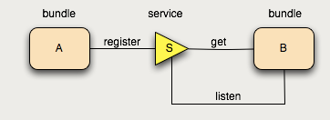
OSGi Services
The Framework Service Registry is available to all bundles to collaborate with other bundles.
Different bundles (from different vendors) can implement the same interface
  Implementation is not visible to users
  Allows operator to replace implementations without disrupting service
A bundle can create an object and register it with the OSGi service registry under one or more interfaces.

Slide 21
Other bundles can go to the registry and list all objects that are registered under a specific interfaces or class.
A bundle can therefore register a service, it can get a service, and it can listen for a service to appear or disappear.
Multiple bundles can register objects under the same interface or class with the same name.
Services are associated with properties
  Powerful query language to find appropriate service
  Bundles can update the properties of a service dynamically
A bundle can decide to withdraw its service from the registry while other bundles are still using this service

Slide 22
A bundle can use a service (bind to) with any cardinality
  1..1, 0..1, 0..n
A service can be discovered dynamically
  Active search with query filter
  Listener interface
Services are dynamic
  A bundle can decide to withdraw its service from the registry while other bundles are still using this service. Bundles using such a service must then ensure that they no longer use the service object and drop any references.
Services can go away at any time! This is very dynamic!

Slide 23
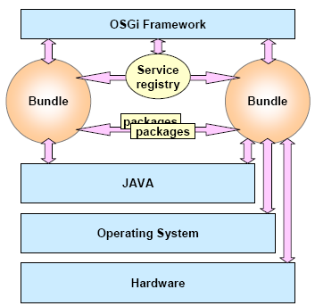
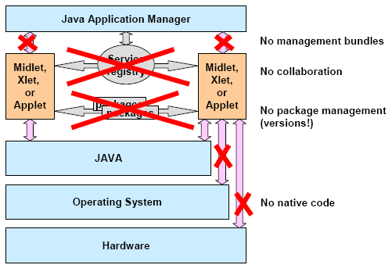
Component interaction and collaboration

Slide 24
Functionalities supported by OSGi
Reduces the complexity of the system.
Managing service/component dependencies.
Makes the components loosely-coupled and easy to manage.
Increases the performance of the system.

Slide 25
OSGi increase performance.
Consider a scenario where you have a large application which uses a logging framework.
This logging framework can be deployed as an OSGi Bundle, which can be managed independently.
Therefore, it can be started when required by our application and can be stopped when not in use.
Also the OSGi container makes these bundles available as services, which can be subscribed by other parts of application.

Slide 26
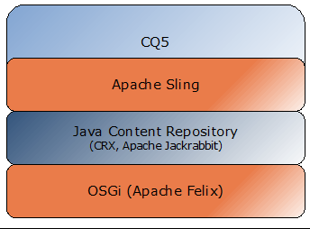
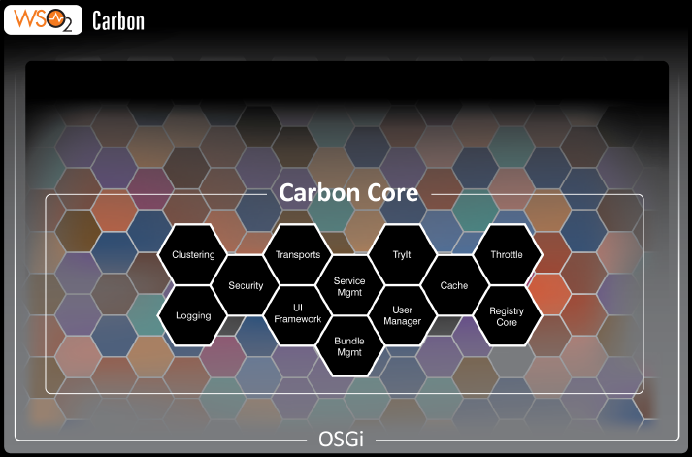
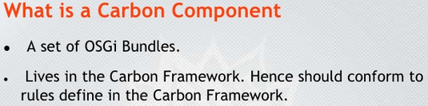
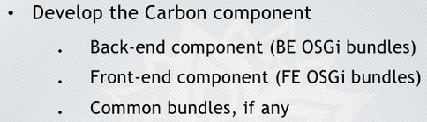
Custom products uses OSGi
Adobe CQ (CMS app)
CQ5, uses the Apache Felix implementation of OSGI.
Apache Felix is a open-source project to implement the OSGi R4 Service Platform.
That includes
- OSGi framework and standard
services.
- OSGi-related technologies.

Slide 27
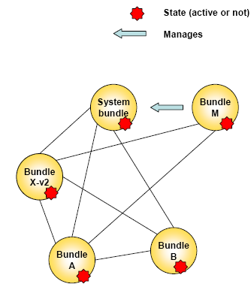
Layers: OSGi Life Cycle Layer
System Bundle represents the OSGi Framework
Provides an API for managing bundles
  Install
  Resolve
  Start
  Stop
  Refresh
  Update
  Uninstall

Slide 28
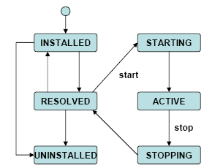
Layers: OSGi Life Cycle Layer
Bundle is started by the Bundle Activator class
Header in the JAR manifest file refer to this class
Bundle Activator interface has 2 methods
  Start: Initialize and return immediate
  Stop: Cleanup
The Bundle Activator gets a Bundle Context that provides access to the OSGi Framework functions.
The Framework provides the Start Level service to control the start/stop of groups of applications.

Slide 29
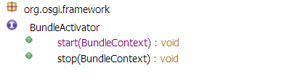
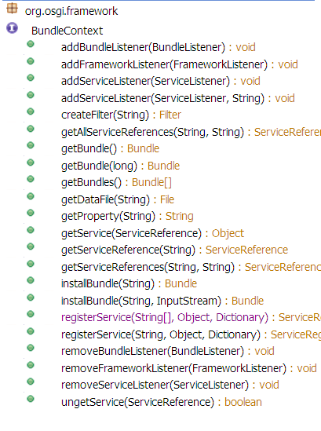
OSGI life cycle methods
States of bundles
Installed – finish bundle installation
Active – start the bundle
Resolved – stop the bundle
Notes:
http://grepcode.com/file/repository.grepcode.com/java/eclipse.org/3.5/org.eclipse/osgi/3.5.0/org/osgi/framework/BundleContext.java#BundleContext.getBundle%28long%29

Slide 30
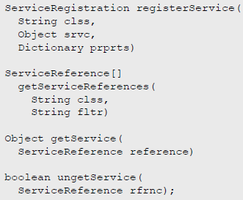
Manipulating Services
The Bundle Context provides the methods to manipulate the service registry
Services registrations are handled by Service Registration objects
  They can be used to unregister a service or modify its properties
Service Reference objects give access to the service as well as to the service’s properties
Access to service objects is through the getService method. These services should be returned with the ungetService method.

Slide 31
References
http://www.osgi.org/Main/HomePage
http://www.osgi.org/Technology/WhatIsOSGi
http://en.wikipedia.org/wiki/OSGi
http://grepcode.com/file/repository.grepcode.com/java/eclipse.org/3.5/org.eclipse/osgi/3.5.0/org/osgi/framework/BundleContext.java#BundleContext.getBundle%28long%29
http://felix.apache.org/site/apache-felix-framework-usage-documentation.html

